Slide 1
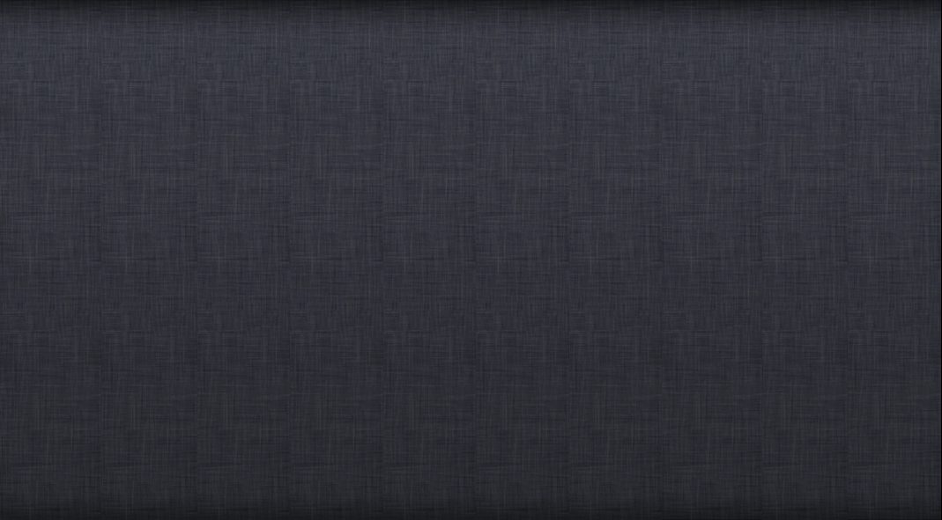
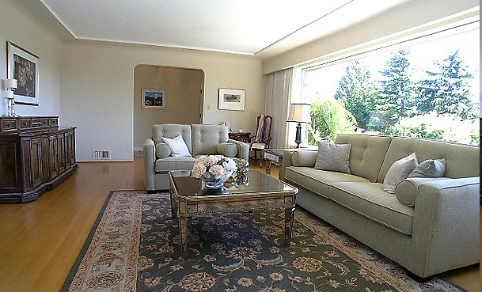
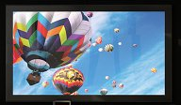

Slide 2
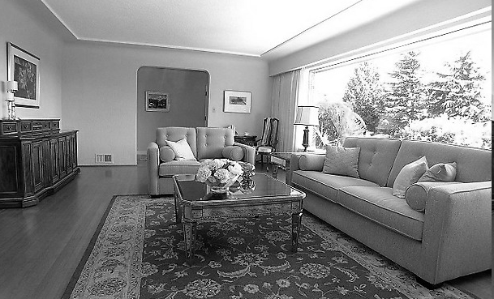

Which way do I face? Window or the TV? Darn…

Slide 4
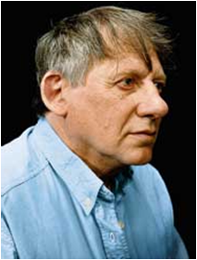
Recurring problem in a specific context
Elegant solution
A pattern! We can give it a name
Christopher Alexander

Slide 5
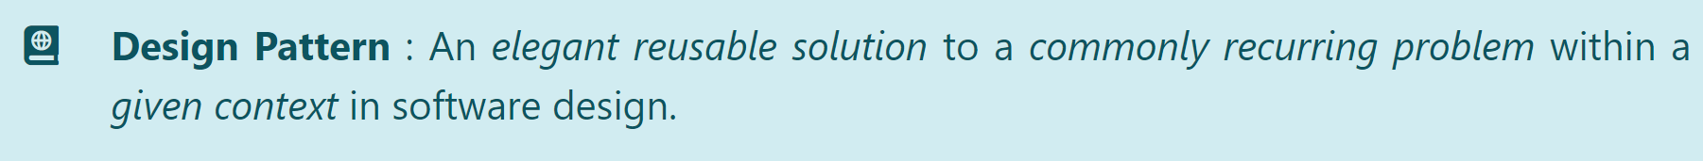
1. Singleton 2. Façade 5. MVC 6.Observer
[There are other types of patterns in SE domain]

Slide 6
Pattern
Context
– where does this occur
Problem
– the main difficulty
Solution
– elegant solution; may need refinement
Anti-pattern
– incorrect, but commonly used

Slide 7
1. Singleton 2. Façade 5. MVC 6.Observer
Context: one-and-only-one object, shared among others

Slide 8
1. Singleton 2. Façade 5. MVC 6.Observer
Context: one-and-only-one object, shared among others
Problem: how to avoid multiple objects?

Slide 9
1. Singleton 2. Façade 5. MVC 6.Observer
Solution:
Logic
- Logic( )
+ getInstance( ) : Logic

Slide 10
1. Singleton 2. Façade 5. MVC 6.Observer
Solution:
Logic
- theOne : Logic
- Logic( )
+ getInstance( ) : Logic

Slide 11
1. Singleton 2. Façade 5. MVC 6.Observer
Solution:
public static Logic getInstance(){
if (theOne == null) theOne = new Logic();
return theOne;
}
Logic
- theOne : Logic
- Logic( )
+ getInstance( ) : Logic
//somewhere else in the system…
Logic logic = Logic.getInstance();
//instead of …
Logic logic = new Logic();

Slide 12
1. Singleton 2. Façade 5. MVC 6.Observer
Why not make all members static instead?
OO ↓
Controlled access ↓
TextUI
Logic
LogicSub
Singleton – Reduces testability

Slide 13
Patterns are documented in a standard format
1. Singleton 2. Façade 5. MVC 6.Observer
Context: one-and-only-one object, shared among others
Problem: how to avoid multiple objects?
Solution:
public static Logic getInstance(){
if (theOne == null) theOne = new Logic();
return theOne;
}
Logic
- theOne : Logic
- Logic( )
+ getInstance( ) : Logic
//somewhere else in the system…
Logic logic = Logic.getInstance();
//instead of …
Logic logic = new Logic();

Slide 14
1. Singleton 2. Façade 5. MVC 6.Observer
Logic
TextUI
ATD

Slide 15
1. Singleton 2. Façade 5. MVC 6.Observer
Logic
TextUI
MSLogic
ATD

Slide 16

1. Singleton 2. Façade 5. MVC 6.Observer
UML notation for stereotypes
<<Client>>
Client1
<<Façade>>
<<Client>>
Client2

Slide 17
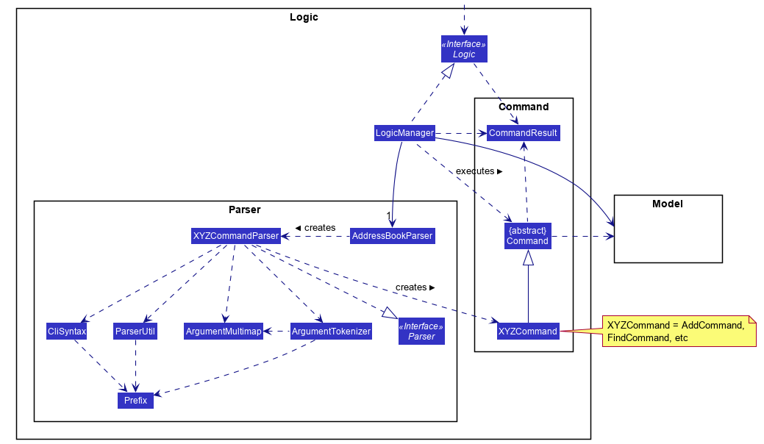
1. Singleton 2. Façade 5. MVC 6.Observer
Façade pattern in AB3

